Slide 1
Operating Systems
Course #06
Processes
Răzvan Daniel ZOTA
Faculty of Cybernetics, Statistics and Economic Informatics
zota@ase.ro
https://zota.ase.ro/os

Slide 2
The OS and processes
Definitions
What’s about?
Process scheduling/multiprogramming
Communication between processes

Slide 3
Processes
Definitions
A program represents something passive, static; a process is active (Remember: process = instance of a program in execution). A process may have several attributes associated with it: the state, allocated memory, CPU resources, the recorded progress.
Why do we need processes ?
  In order to share logical resources (files) and physical resources (hardware devices).
  To improve the computing speed, by implementing multiprogramming.
  Using modularity for protection.

Slide 4
Introduction
The main function of a processor is the one to run machine instructions from the main memory.
These instructions are part of some programs. For efficiency and easy to use, a processor may interleave portions from different programs (processes) during execution.
In order to run a program, the OS is creating a process (or a task) associated with that program.

Slide 5
Introduction
From the processor’s point of view, it executes instructions from a “repertoire” following the order dictated by the PC (Program Counter) register (also known as Instruction Pointer register).
During execution, PC may point to the code from different programs that are parts of different processes.
By an individual program point of view, its execution implies a set of instructions from that program.

Slide 6
The process’ trace
We may characterize the behaviour of an individual process by listing the sequence of instructions in execution for that process.
This kind of list is called the process’ trace. We may characterize the processor’s behaviour by knowing the traces for different processes and the way these traces are interleaved.

Slide 7
The process’ traces – example
0
We consider a memory map (for 3 processes) in the simple example of figure 1
To make the things simpler, we may assume that we don’t use virtual memory; all three processes are fully loaded into main memory.
100
Program Counter
Dispatcher
10000
6000
Process A
10000
Process B
16000
Process C
Figure 1. Simple execution example for 3 processes – memory map

Slide 8
The process’ traces - example
Additionally, there is a small program called the dispatcher, which commutes processor’s execution from one process to another.
In figure 2 we may see the traces for that 3 processes at the beginning of their execution.
The first 16 instructions for A and C processes are shown.
Process B executes 6 instructions and we assume that the 6th instruction make a call to an I/O instruction which termination implies a delay in processors’ execution .
6000
6001
6002
6003
6004
6005
6006
6007
6008
6009
6010
6011
6012
6013
6014
6015
10000
10001
10002
10003
10004
10005
16000
16001
16002
16003
16004
16005
16006
16007
16008
16009
16010
16011
16012
16013
16014
16015
2) Process B trace
3) Process C trace
1) Process A trace
Figure 2. The process traces for figure 1

Slide 9
The process’ traces (cont.)
Let us consider these traces by the processors’ point of view. In figure 3 we see the interleaved traces resulting from the execution of the first 70 instruction cycles. We assume that the OS enables each process to continue its execution for maximum 8 instruction cycles and after that the process’ execution is interrupted (this avoids the processor’s monopolization by a certain process).
As we may see in figure 3 the first 8 instructions of process A are executed, followed by a “time-out” and the execution of a portion of code of the dispatcher, which executes 8 instructions before offering the control to process B. After the first 6 instructions of process B are executed, B asks for an I/O operation of which result must be waited for.

Slide 10
The process’ traces (cont.)
As a result, the processor stops the execution of process B and gets to the execution of process C (after the execution of the dispatcher’s code).
After another moment of “time-out”, the processor is moving to process A again. Meanwhile, the process B waits for the I/O operation to terminate, and the dispatcher is commuting again to process C.

Slide 11
The process’ traces (cont.)
1 6000
2 6001
3 6002
4 6003
5 6004
6 6005
7 6006
8 6007
17 10000
18 10001
19 10002
20 10003
21 10004
22 10005
31 16000
32 16001
33 16002
34 16003
35 16004
36 16005
37 16006
38 16007
47 6008
48 6009
49 6010
50 6011
51 6012
52 6013
53 6014
54 6015
I/O request
23 100
24 101
25 102
26 103
27 104
28 105
29 106
30 107
time-out
time-out
time-out
39 100
40 101
41 102
42 103
43 104
44 105
45 106
46 107
55 100
56 101
57 102
58 103
59 104
60 105
61 106
62 107
9 100
10 101
11 102
12 103
13 104
14 105
15 106
16 107
Figure 3. The interleaved traces for the processes presented in figure 1

Slide 12
The process’ traces (cont.)
63 16008
64 16009
65 16010
66 16011
67 16012
68 16013
69 16014
70 16015
time-out
Figure 3. The interleaved traces for the processes presented in figure 1 (cont.)

Slide 13
Process scheduling
The process scheduling is the activity of the process manager that handles the removal of the running process from the CPU and the selection of another process on the basis of a particular strategy.
Process scheduling is an essential part of a multiprogramming operating system.
Such operating systems allow more than one process to be loaded into the executable memory at a time and loaded process shares the CPU using time multiplexing.

Slide 14
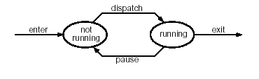
Two states process model
Process scheduling is using a mechanism of scheduling queues. In such a mechanism, when a process enters into the system, it is put into a job queue. In order to know the state of a process at a moment in time, some models are used. The most simple model is the model with two states.
Notes:
A job queue consists of all processes in the system and the OS also maintains other queues such as device queue. Device queue is a queue for which multiple processes are waiting for a particular I/O device and each device has its own device queue.

Slide 15
Two states process model
In the model with two states we have:
Running state -when a new process is created and the process enters in the running state.
Not-running – processes that are not running are kept in a queue waiting for their turn to execute

Slide 16
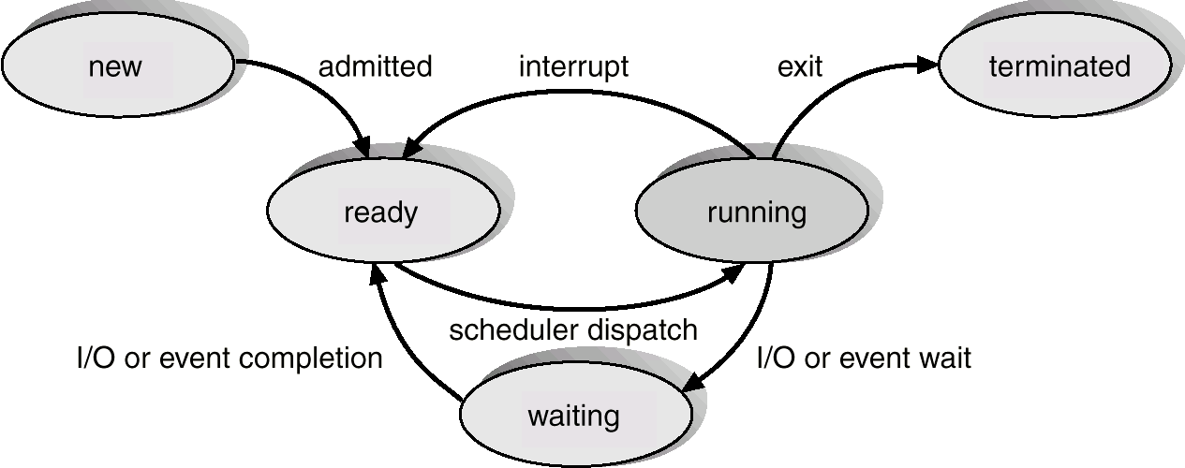
A process model with 5 states
New The process have been created.
Ready (to execute) The process has got all the necessary resources, waiting to get into execution.
Waiting It waits for an event (hardware, user intervention or waits for another process).
Running In this case the instructions are executed; the running process uses the CPU.
Suspended/terminated Another process have “ordered” that the process must go into suspended state (“go to sleep”). The suspended process will be awaken by another process / The process have suspended its execution.
Figure 4. Process model with 5 states

Slide 17
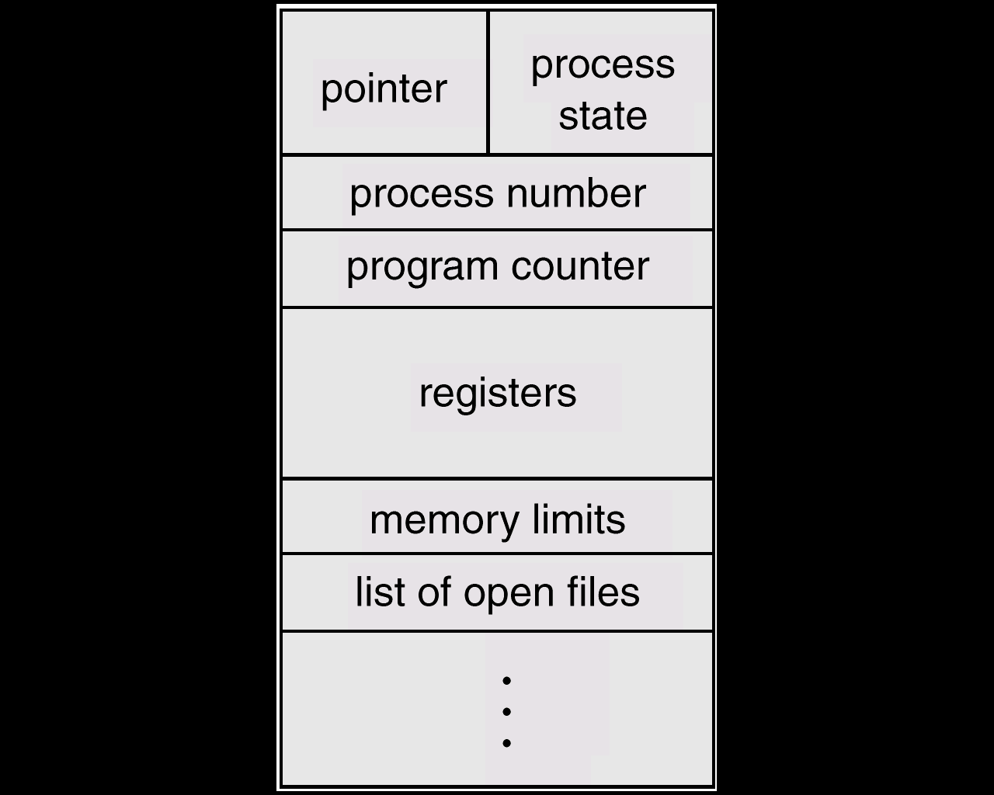
Process states
Process control block (PCB):
It contains information associated with each process.
It has the following structure:
PC (Program Counter), CPU registers
Memory management information
Accounting information (used time, process id, etc..)
The I/O state (resources allocated to files, etc.)
Data about scheduling (priorities, etc. )
The process state (in execution, suspended, waiting, etc.)
Figure 5. Process control block

Slide 18
Process scheduling
Process scheduling means, actually, modifying the PCB; another name for it is: context switch.
A context switch can be considered as a process switch.
The switch makes the shift from the memory allocated to a process to the memory allocated to another process (each process has its own “view” about memory) (see Figure 6)
Scheduling queues:
(a process is determined by some events which appear because of the needs and the availabilities)
  “ready to execute” queue = is made of all the processes ready to execute.
  I/O queue (waiting state) = is made of all the processes that wait a I/O process to end.
The queue implementation can be made by simple or double linking.

Slide 19
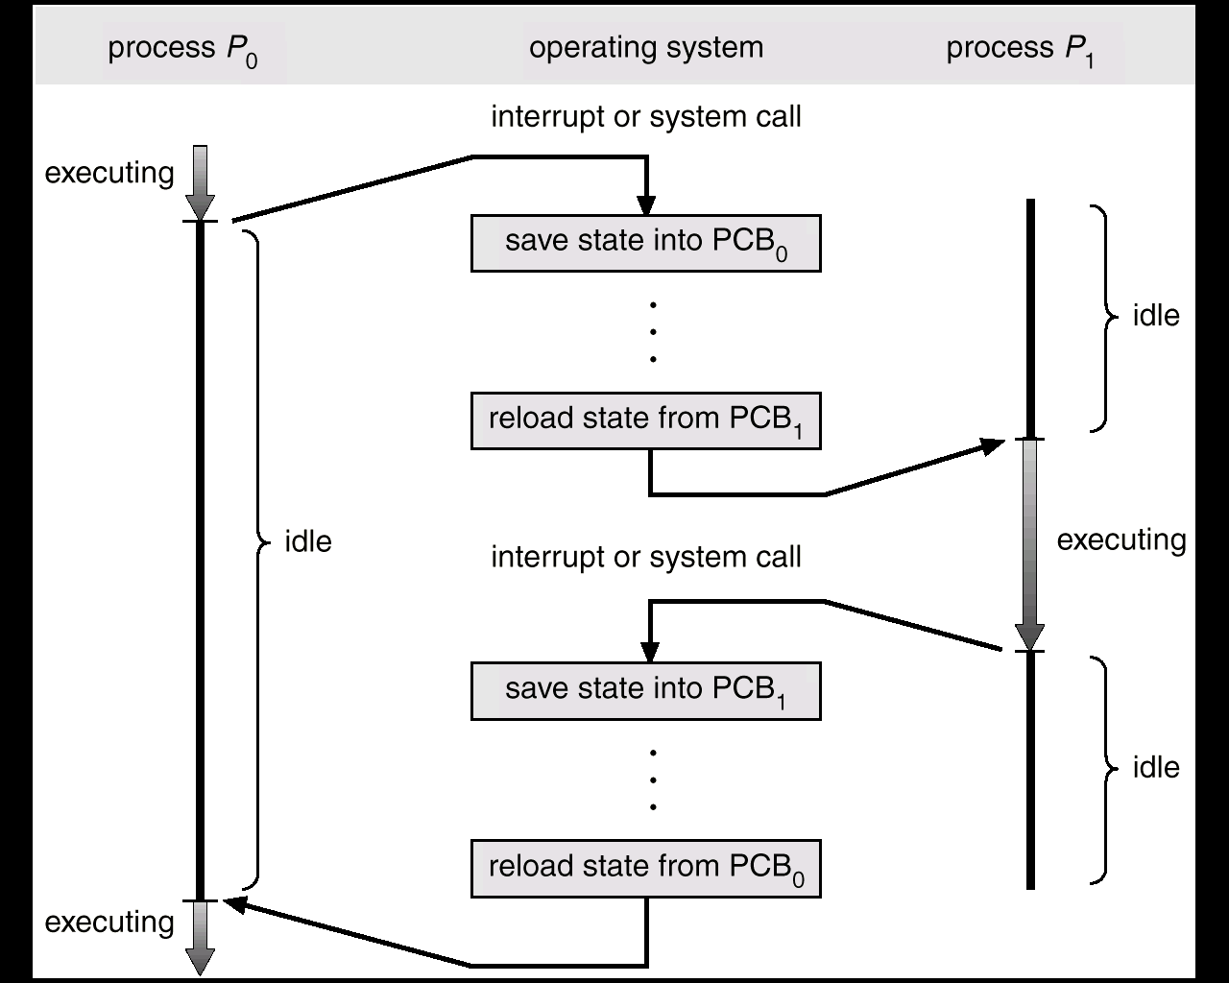
Process scheduling
Figure 6. How a context switch works

Slide 20
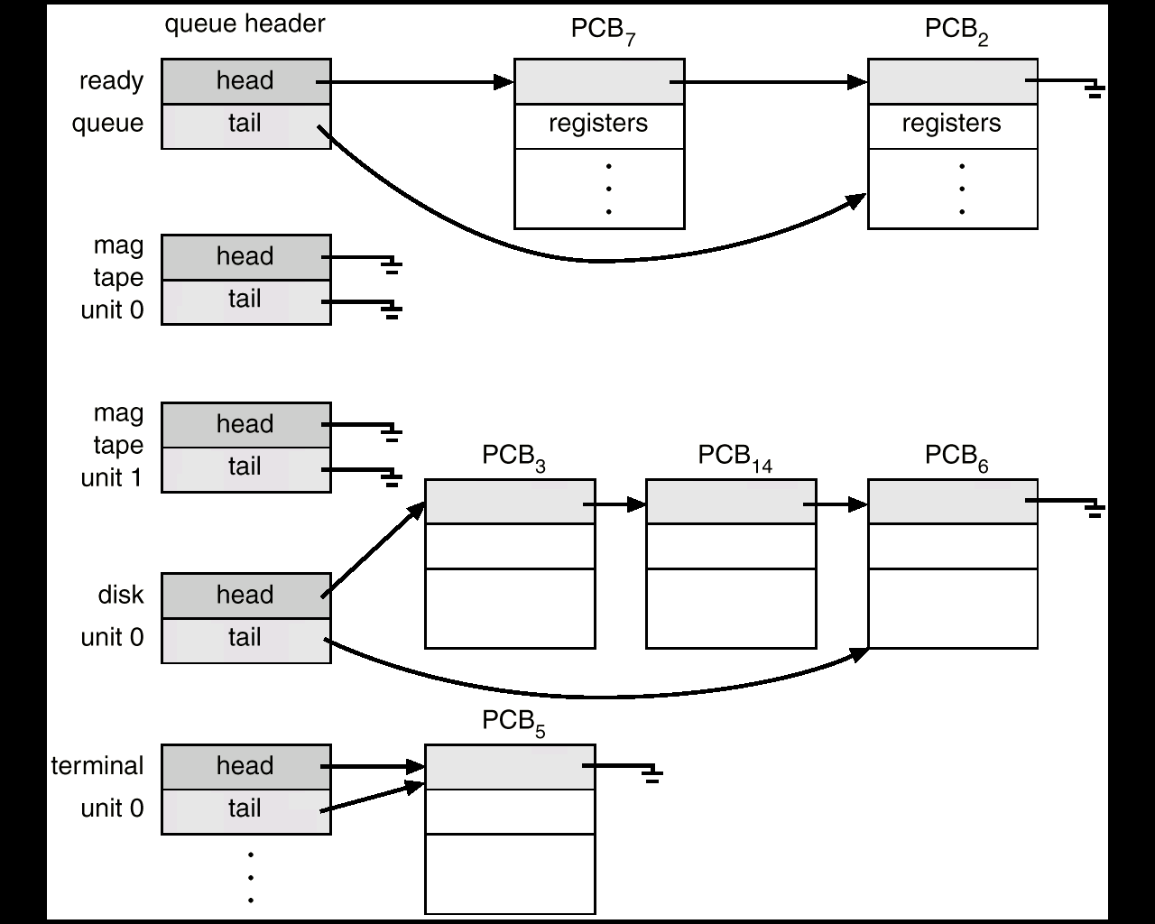

Process scheduling
Ready to execute Queue
Figure 7. Queue examples

Slide 21
Scheduling: Long term scheduler
The long term scheduler (admission scheduler) decides which jobs/processes are admitted in the “ready to execute” queue.
When a program must run, its admission in the queue is authorized or delayed by the long term scheduler.
In this way the scheduler decides which processes will run on a system and the degree of concurrency at a moment in time (a greater or lesser number of processes are executed concurrently and how to divide them into I/0 intensive and CPU intensive processes).

Slide 22
Scheduling: Long term scheduler
In case of a desktop system there is no need for such a scheduler; it is used in case of large-scale systems or real-time systems when the capacity of the system to satisfy the deadlines of the processes can be compromised if too many processes are admitted in the “ready to execute” queue.
It’s main characteristics are:
It is running only when the job comes from memory
It controls the degree of multiprogramming
It maintains an equilibrium between the input/output rate in/from the queue by jobs’ selection

Slide 23
Scheduling: Short and medium term scheduler
The short term scheduler (CPU scheduler) decides which of the “ready to execute” queue, in-memory processes are to be executed, after an interrupt, an OS system call or another form of a signal.
Also, it can pop out a process from the CPU at the end of its execution (the process can return in “ready to execute” or in “waiting” state).
The code used to get the process from “ready to execute” queue and run it is usually called the dispatcher. The short term scheduler is running frequently and, for this reason, must be short and simple.
The medium term scheduler is used to remove temporarily the processes from main memory and places them in the secondary memory, term commonly referred as swapping.

Slide 24
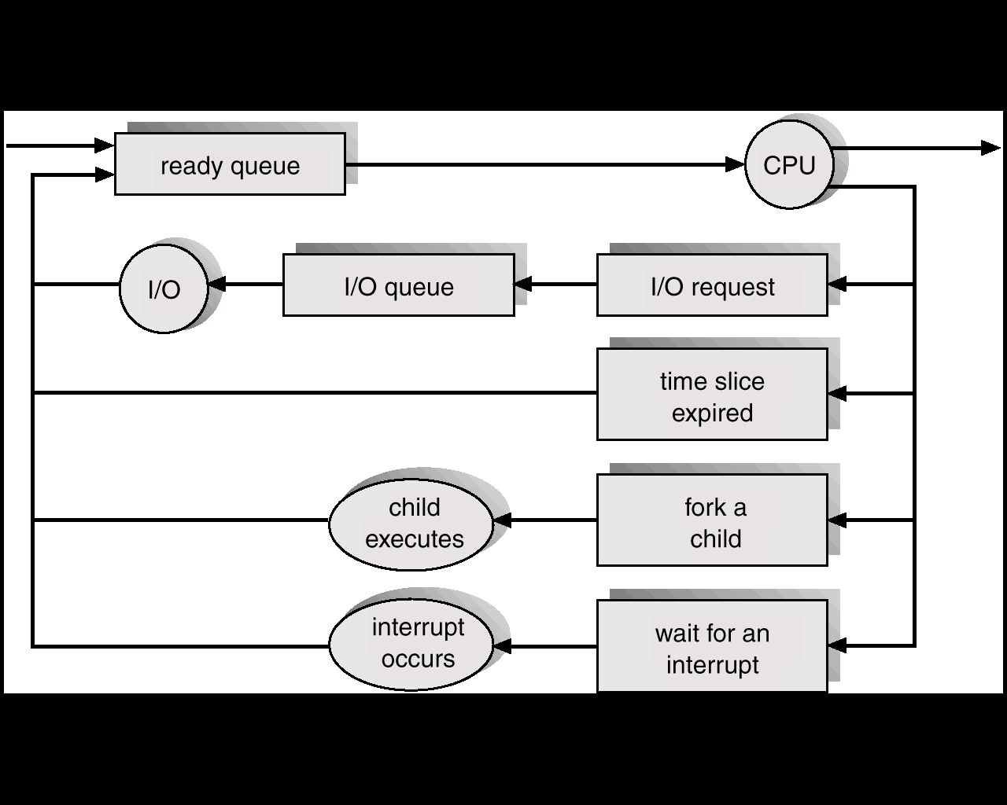
Interrupt handler
The Interrupt Handler, also known as ISR (Interrupt Service Routine), is the “reflex system” of an OS.
There are two main types of interrupts:
-Hardware Interrupts: generated by devices (mouse, keyboard, network card, system timer, etc.)
-Software Interrupts (Traps/Exceptions): generated by programs (for example, a division by zero or a system request to the kernel).
Short term scheduler
Medium term scheduler
Long term scheduler
Short term scheduler
Interrupt handler
Figure 8. “Combining” the scheduling components

Slide 25
Relationships between processes
A process has several stages of “living”: it is born (fork), it is developing (gets into process table) and is active (it is running).
All the processes have a family of a tree shape. A child process has a parent and a parent process may have several children.
There are several exchanges between relations child/parent.
The parent process can run concurrently with the child process or can wait for the child to end its execution.
The child can share (fork/join) all the parent’s resources or just a part of them (UNIX/Linux).
The parent can “kill” the child (when is no needed anymore or if it exhausted the allocated resources).
The “death” of the parent implies, usually, the “death” of the child.

Slide 26
Process intercommunication
There are two basic methods:
- Shared memory – a quick way /no data transfer
- Message passing – a distributed way/a better isolation.
Communication links characteristics:
The way of creating links
Number of processes foe each link
Number of links for each pair of processes
The capacity of the memory buffer – in order to store messages in a queue.
The format and dimension of the messages
Uni or bi-directional
Implementation methods:
Directly or indirectly – to the process or in the mailbox
Buffering mechanism
Sending by copying or making a reference?
Fixed or variable message length?

Slide 27
Direct communication
In this case the identities for the sender and receiver must be known. The procedure is the following:
send (Process_P, message) ;
receive (Process_Q , message);
receive (id, message) <-- from any sender
The standard mechanism used is the so-called Producer/Consumer (a process produces elements that are sent to the consumer in order to use them). Characteristics: only two messages involved, bi-directional.
repeat repeat
producing element receive (producer, nextp)
send (consumer, nextp) consuming element
until false until false

Slide 28
Indirect communication
In this case the processes are communicating through a mailbox. The procedure looks like this:
open(mailbox_name);
send (mailbox_name, message);
receive (mailbox_name, message);
The link is established if the processes have a shared mailbox (the mailbox needs to be set up before sending/receiving).
A mailbox can be accessed by two or more processes.
In the case of multiple receivers the procedure can create confusion: who gets the message?

Slide 29
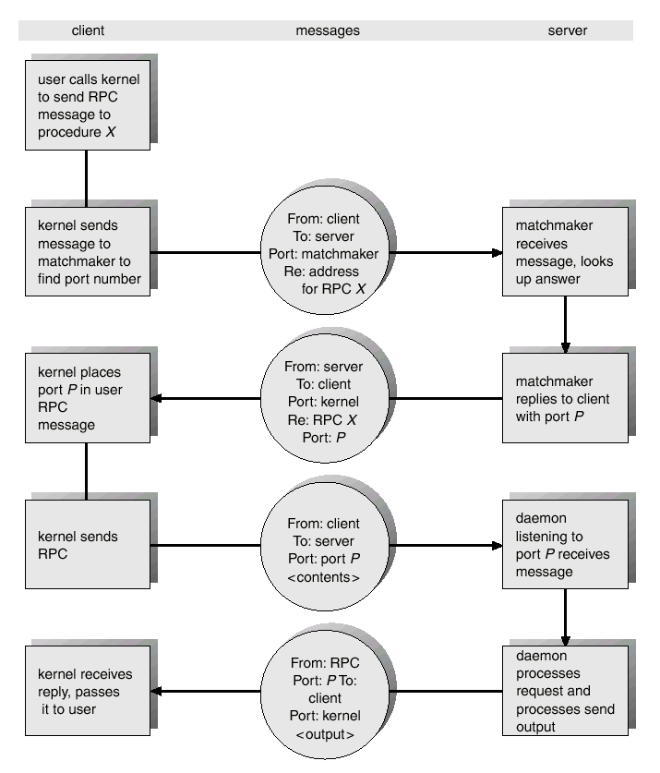
Remote procedure call
Another example for message exchanges, the RPC is abstracting the procedure calls between processes in a network communication.

Slide 30
Linux processes
In the Linux world, a process can create a new process (using fork() and exec() functions). In this case, the process who was created is called a child and its creator is called parent. A process is identified by its process ID (PID) as well as it’s parent processes ID (PPID).
Parent processes – these are processes that create other processes during run-time.
Child processes – these processes are created by other processes during run-time.
Obs.: You can use the pidof command to find the ID of a process. Syntax: $ pidof <process_name>

Slide 31
Linux – practically, two main types of processes
Foreground processes (~interactive processes) – these are initialized and controlled through a terminal session. In other words, there has to be a user connected to the system to start such processes; they haven’t started automatically as part of the system functions/services.
Background processes (~non-interactive/automatic processes) – are processes not connected to a terminal; they don’t expect any user input.

Slide 32
Linux – special processes
Daemons: special types of background processes that start at system startup and keep running forever as a service. They are started as system tasks (run as services), spontaneously and they can be controlled by a user via the init process.
The init process is the parent of all processes on the system, it’s the first program that is executed when the Linux system boots up; it manages all other processes on the system. It is started by the kernel itself, so in principle it does not have a parent process.
The init process always has process ID of 1. It functions as an “adoptive” parent for all orphaned processes.

Slide 33
Linux – process states
Running – in this state, the process is either running or it’s ready to run (it’s waiting to be assigned to the CPU ).
Waiting – in this state, a process is waiting for an event to occur or for a system resource. Moreover, the kernel also differentiates between two types of waiting processes; interruptible waiting processes – these can be interrupted by signals and uninterruptible waiting processes – they are waiting directly on hardware conditions and cannot be interrupted by any event/signal.

Slide 34
Linux – process states (cont.)
Stopped – in this state, a process has been stopped, usually by receiving a signal. For instance, a process that is being debugged.
Zombie: another special state of a process. A zombie process is a process whose execution is completed but it still has an entry in the process table.
You may see the active processes on a Linux system using several commands: ps, top, htop.

Slide 35
Linux – background jobs (processes)
In order to start a process in the background (non-interactive), we may use the & symbol. In this case, the process doesn’t read input from a user until it’s moved to the foreground.
Related commands: jobs, fg, bg.
To send a background process to the foreground, we may use the fg command together with the job ID.
If we suspended a command (with Ctrl+Z), we may continue running the suspended command using the bg command.

Slide 36
Linux – Practical commands: ps and top
ps aux –lists all active processes:
$ ps aux
# USER PID %CPU %MEM VSZ RSS STAT COMMAND
# root 1 0.0 0.1 16952 1876 Ss /sbin/init
# student 1234 2.5 1.2 125432 12340 R python script.py
# student 1235 0.0 0.0 14232 980 S bash
STAT – process state:
R = Running
S = Sleeping (interruptible wait) s=Session Leader
D = Disk sleep (non-interruptible wait – I/O)
Z = Zombie (terminated but not collected by parent)
T = Stopped (suspended by a signal)
Useful commands:
$ ps aux | grep python # filtering by name
$ pstree -p # process tree with pid-s
$ top # real time monitoring
$ htop # interactive top

Slide 37
Linux – Signals and kill command
Signals are representing the mechanism by which processes communicate and are controlled.
Main signals:
SIGTERM (15) – graceful shutdown; process can “clean up” before it terminates
SIGKILL (9) – immediate forced shutdown; cannot be ignored or blocked!
SIGSTOP (19) – suspend process (equivalent to Ctrl+Z)
SIGCONT (18) – resume a suspended process
SIGHUP (1) – configuration reset (used by daemons)
Examples:
$ kill 1234 # default SIGTERM
$ kill -9 1234 # SIGKILL – forced
$ kill -STOP 1234 # suspending process
$ kill -CONT 1234 # suspended process continuation
$ killall firefox # stopping all processes with that name
$ pkill -9 python # kill by a name pattern
$ kill -l # list all available signals

Slide 38
Linux – Prioritatea proceselor: nice și renice
Priority in Linux is the nice value and varies from -20 (maximum priority) to +19 (minimum priority). Default value: 0
# Priority scale:
-20 ← MORE IMPORTANT ───── 0 ─────── LESS IMPORTANT → +19
# (root) (default) (background processes)
nice – running a process with a specified priority
$ nice -n 19 ./program.sh # minimum priority – no problem
$ sudo nice -n -10 ./critical.sh # high priority (needs root)
renice – changing the priority of a running process
$ renice -n 10 -p 1234 # lowers the priority of PID 1234
$ sudo renice -n -5 -p 1234 # increase priority (root!)
$ renice -n 15 -u student # all the processes of a user
Check priority in ps:
$ ps -o pid,ni,comm | head -10
# Coloana NI = current nice value

Slide 39
Zombie and orphan processes
Zombie process – process that has terminated but not collected by the parent process:
Child terminates → sends SIGCHLD to the parent → parent must call wait()
If the parent does NOT call wait() → child remains a zombie in the process table
Zombie does NOT consume CPU or memory, but occupies a slot in the process table
Orphan Process – a process whose parent has finished executing:
Parent dies → child is left without a parent → automatically adopted by init/systemd (PID 1)
Orphan process continues to run normally – not a problem in itself
The nohup command intentionally creates orphan processes that survive logout:
$ nohup ./server.sh > output.log 2>&1 &
# the process runs even if you close the terminal!
Comparison:
Zombie = terminated, “ghost” in the process table
Orphan = alive, adopted by init → normal behavior

Slide 40
Linux – Foreground, Background și job control
Foreground – the process blocks the terminal; receives input from the user
$ nano script.bash # terminal blocat!
# Ctrl+C → stop (SIGINT)
# Ctrl+Z → suspended (SIGSTOP)
Background – the process runs independently; the terminal remains free
$ sleep 500 & # & sends in the background
# [1] 5678 ← job number and PID
Job Control – main commands:
$ jobs # active jobs list
# [1]+ Running python3 script.py &
# [2]- Stopped nano script.bash
$ fg 1 # brings job 1 in foreground
$ bg 2 # continue job 2 suspended in the background
nohup – continues after logout:
$ nohup ./script.sh > out.log 2>&1 &
# the process is running even after stopping the terminal

Slide 41
Linux – systemd and daemons view
On Linux, init = systemd (PID 1) – manages all daemons:
$ pstree | head -4
# systemd─┬─accounts-daemon
# ├─cron
# ├─sshd───sshd───bash───pstree
# └─nginx───4*[nginx]
systemctl – main command for managing services:
$ systemctl status nginx # Service state
$ systemctl start nginx # starting
$ systemctl stop nginx # stopping
$ systemctl restart nginx # restarting
$ systemctl enable nginx # automated start at boot time
$ systemctl disable nginx # disabling at boot
$ systemctl list-units --type=service --state=active
# list of all active services
Daemons’ log view:
$ journalctl -u nginx # viewing logs for nginx service
$ journalctl -f # real time logs

Slide 42
Windows – PowerShell
Get-Process – ps aux equivalent for Windows:
PS> Get-Process
# Handles NPM(K) PM(K) WS(K) CPU(s) Id ProcessName
# 342 18 8234 15432 1.25 1234 chrome
# 128 8 2100 4532 0.03 892 notepad
Filtering and stopping processes:
PS> Get-Process -Name chrome # filtering by name
PS> Stop-Process -Name notepad # elegant stop
PS> Stop-Process -Id 1234 -Force # forced stop = SIGKILL
PS> Stop-Process -Name chrome -Force # all instances
Sorting by CPU usage:
PS> Get-Process | Sort-Object CPU -Desc | Select -First 10
Parent-child relationships:
PS> Get-CimInstance Win32_Process |
Select ProcessId, ParentProcessId, Name | Sort ProcessId

Slide 43
Windows – Services
On Windows, the daemons are called services and are managed by the SCM (Service Control Manager)
PowerShell commands for services:
PS> Get-Service # list all services
PS> Get-Service -Name wuauserv # Windows Update
PS> Start-Service -Name Spooler # Print Spooler start
PS> Stop-Service -Name Spooler # stop
PS> Restart-Service -Name Spooler # restart
PS> Set-Service -Name Spooler -StartupType Automatic
# automated start at boot time
SYSTEM process (PID 4):
Equivalent for init/systemd on Linux → first Windows process (PID 4)
svchost.exe is hosting multiple services in one process
Graphical tool:
Process Explorer (Sysinternals/Microsoft)

