Slide 1
Regular expressions
A Regular Expression is a collection of "normal" and "special" characters that are used to match simple or complex patterns. Normal characters are alphanumeric characters which match themselves. For example, an a would match an a.
Regular Expression | Matches
. | Any single character
[ ] | A list or range of characters to match one character, unless the first character is the caret ^, and then it means any character not in the list
* | Previous character repeated zero or more times
^ | Following text must appear at beginning of line
$ | Preceding text must appear at the end of the line

Slide 2
Regular expressions
. Match any single character (except newline)
[abcABC] - Match any one character within the brackets
[^abcABC] - Match any one character except the ones in the brackets
[a-z] - Match any character in the range
[^a-z] - Match any character except the ones in the range
monday|tuesday - Find either of the listed strings
^ - Start of a line
$ - End of a line

Slide 3
Regular expressions - examples
$ echo 'abcddd' > example.txt
$ cat example.txt
abcddd
$ grep 'a..' example.txt
abcddd
$ grep 'a..c' example.txt

Slide 4
Regular expressions - examples
For example, the following command matches two characters, the first is either an a or a b while the second is either an a, b, c or d:
$ grep '[ab][a-d]' example.txt
abcddd
Note that you can either list out each possible character [abcd] or provide a range [a-d] as long as the range is in the correct order. For example, [d-a] wouldn't work because it isn't a valid range:
$ grep '[d-a]' example.txt
grep: Invalid range end

Slide 5
Regular expressions - examples
To indicate that you want to match a character that is not one of the listed characters, start your [ ] set with a ^ symbol. For example, the following will demonstrate matching a pattern that includes a character that isn't an a, b or c followed by a d:
$ grep '[^abc]d' example.txt
abcddd
The * character can be used to match "zero or more of the previous character". For example, the following will match zero or more d characters:
$ grep 'd*' example.txt
abcddd

Slide 6
Regular expressions - examples
When you perform a pattern match, the match could occur anywhere on the line. You may want to specify that the match occurs at the beginning of the line or the end of the line. To match at the beginning of the line, begin the pattern with a ^ symbol.
In the following example, another line is added to the example.txt file to demonstrate the use of the ^ symbol:
$ echo "xyzabc" >> example.txt
$ cat example.txt
abcddd
xyzabc
$ grep "a" example.txt
abcddd
xyzabc
$ grep "^a" example.txt
abcddd

Slide 7
Regular expressions - examples
In order to specify the match occurs at the end of line, end the pattern with the $ character. For example, in order to only find lines which end with the letter c:
$ grep "c$" example.txt
xyzabc
$ grep "cd*" example.txt
abcddd
xyzabc
abcd*
If you want to look for an actual * character, place a \ character before the * character:
$ grep "cd\*" example.txt
abcd*

Slide 8
REGEX - other practical examples
Step 1: We are creating the test file
$ echo -e “viorica@gmail.com\nbob123\nion.ionescu@yahoo.ro\n12345\ntest_user" > test.txt
Step 2: Finding the email addresses
$ grep '[a-zA-Z0-9._]*@[a-zA-Z]*\.[a-z]*' test.txt
Step 3: Finding only the lines with numbers
$ grep '^[0-9]*$' test.txt
Challenge: write a REGEX using grep command that finds telephone numbers starting with 07 and having a total of 10 digits.

Slide 9
REGEX - other practical examples
Hint: grep -E '^07[0-9]{8}$' test.txt
Discussion…

Slide 10
Part 2:
More on OS structure and components

Slide 11
OS components & structure
Components
System calls
Components integration
Virtual machines

Slide 12
SO components
Process management
Main memory management
File management
I/O system management
Secondary memory management
Network connection
Protection system
Command interpreter system

Slide 13
Process management
A process is an instance of a program in execution (if a program is passive, a process is active).
A process has access to several resources (CPU time, memory, files) and it has attributes to be managed.
The process management includes the following:
Process scheduling (establishing priorities, time management, etc.)
Creation/Termination
Blocking/Unblocking (Suspending/Reloading)
Synchronization
Communication
Deadlock management
Debugging

Slide 14
Memory management
Process, files and I/O operations allocation/de-allocation.
Simultaneous processes management
It takes into account who is using memory
Moving process memory from/to secondary memory

Slide 15
File management
A file is a collection of data or information defined by its creator.
Normally, the files may represent programs (source programs or executable programs) or data.
The OS is responsible with the following activities related to file management:
Creating and erasing files
Creating and erasing directories
Oferring support for handling files and directories
Moving files to secondary storage
Making backups for file on non-volatile storage media

Slide 16
I/O & secondary memory management
I/O
Generic code for device drivers
Drivers for each device – translate the reading/writing demands in positioning commands on disk
Secondary memory
Disks, magnetic-optical storage, etc.
Free space management (paging/swapping)
Allocating space on disk (what data are written and where on the disk)
Scheduling reading/writing from/to disk

Slide 17
OS components
Network connection
Communication system between distributed processors
Getting information about files/processes, etc. on a remote machine
Can use a “message passing” model or a shared memory model
Protection
Files, memory, CPU, etc.
= Access control
Depends on the attributes of a file or user
System programs
Compilers/link-editors/assemblers, etc.
Communications (ssh, sftp, curl, scp, etc.)
Command interpreters– programs that take control sequences (commands) (shell, graphical interface)
How these components interacts ?
All offer services one another

Slide 18
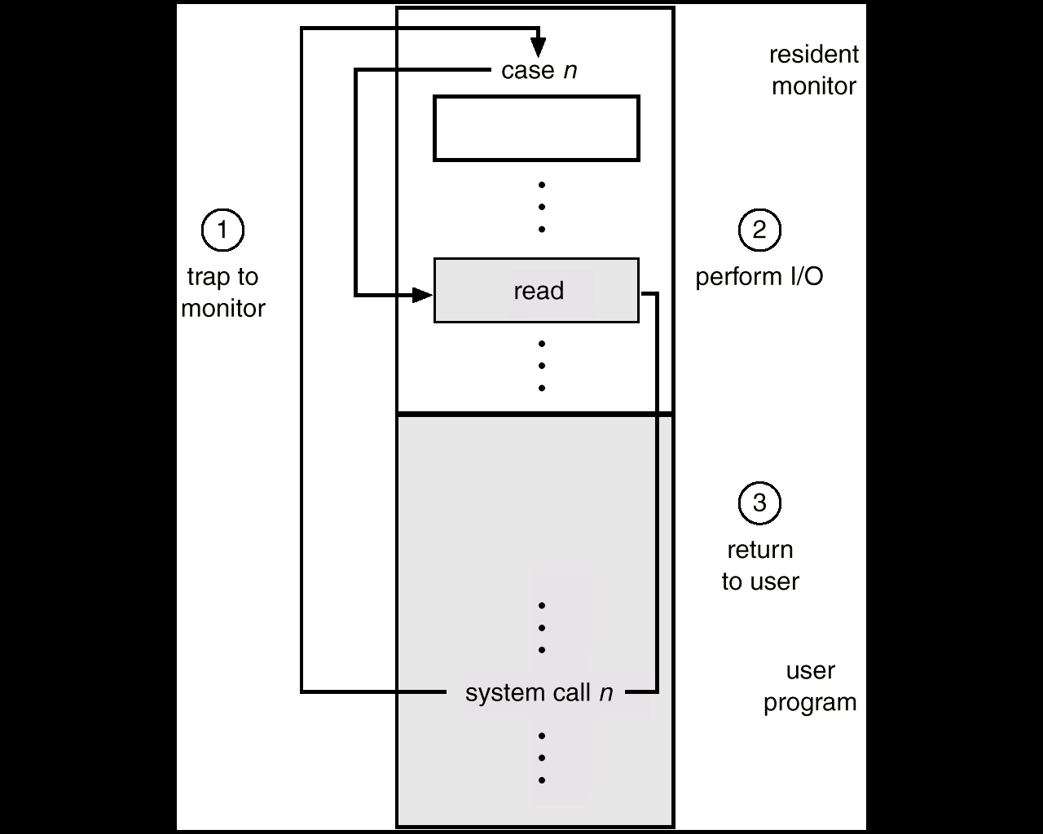
OS components
A system call represents the main way a user program interacts with the OS.

Slide 19
Comanda strace in Linux
strace = system call tracer — intercepts and prints in real time all system calls made by a program to the kernel.
Examples: 1. View the system calls of the ls command:
$ strace ls 2>&1 | head -20
2. View the system calls made by a simple C program (which displays a message on the screen):
$ strace ./hello 2>&1 | grep 'open\|read\|write'

Slide 20
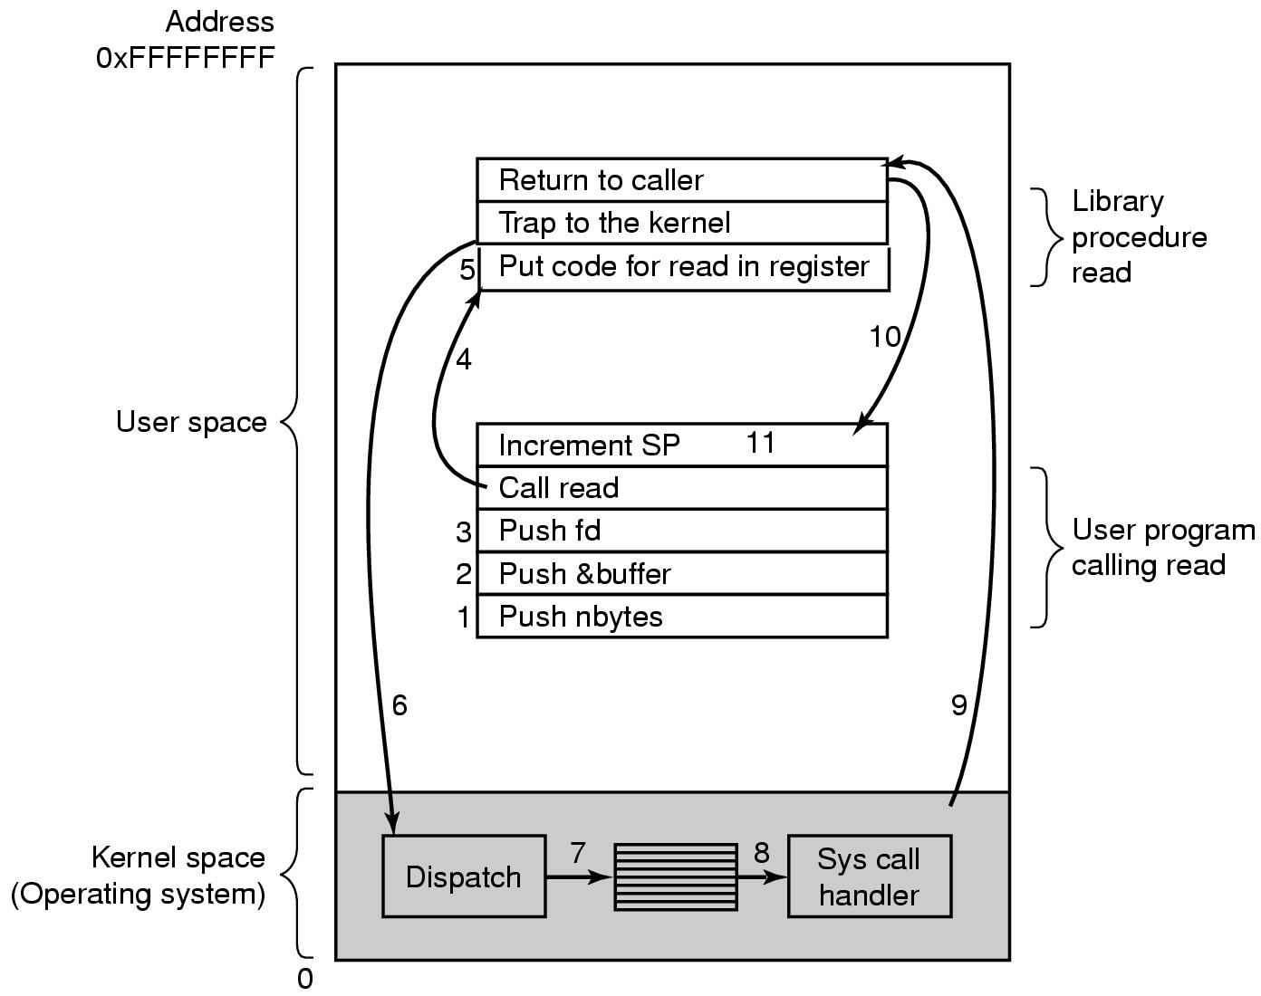
How a system call works
Get access to system space
Parameters validation
Call system’s resources
Interrogates an equipment/system for a certain element
It suspends waiting for an equipment
The interrupt may have the result that a thread is ready to execute
Masking
Return to user
There are more steps involved in a system call
read (fd, buffer, nbytes)
Notes:
A trap is an exception in a user process. It's caused by division by zero or invalid memory access. It's also the usual way to invoke a kernel routine (a system call) because those run with a higher priority than user code. Handling is synchronous (so the user code is suspended and continues afterwards). In a sense they are "active" - most of the time, the code expects the trap to happen and relies on this fact.
An interrupt is something generated by the hardware (devices like the hard disk, graphics card, I/O ports, etc.). These are asynchronous (i.e. they don't happen at predictable places in the user code) or "passive" since the interrupt handler has to wait for them to happen eventually.

Slide 21
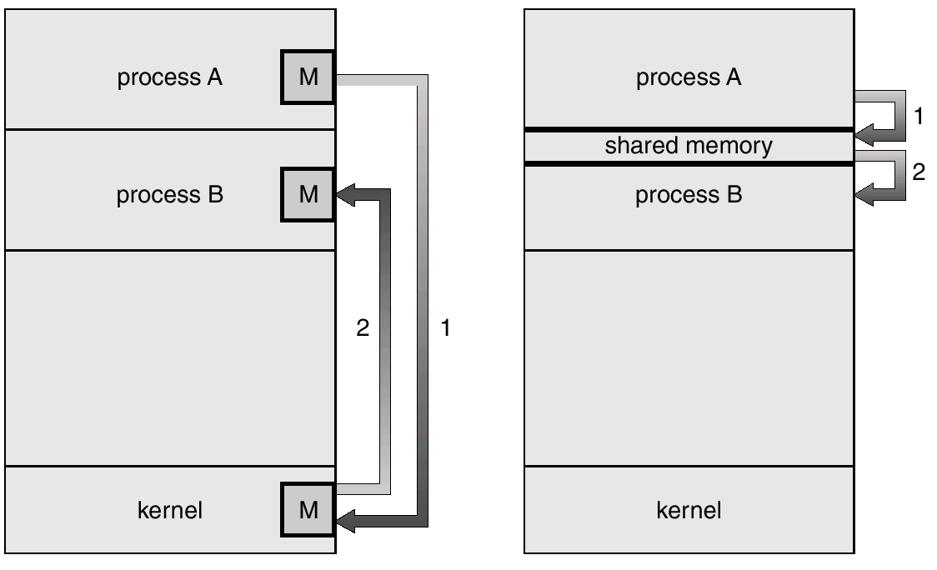
There are two main methods to transfer data between programs:
Message passing
Shared memory

Slide 22
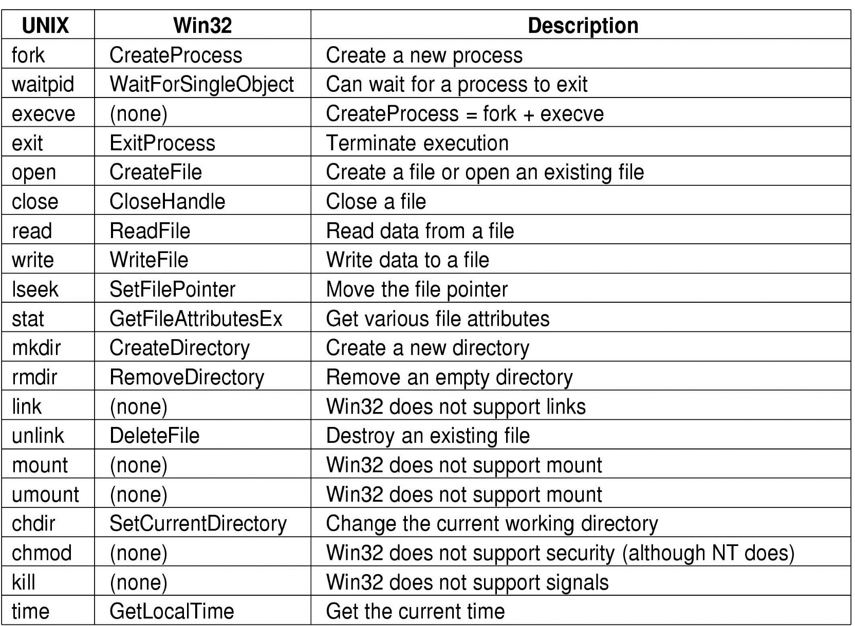
System calls examples:

Slide 23
A simple structure: MS-DOS
Application programming
Resident system programs
Obs: All these levels can access the hardware
MS-DOS drivers
ROM - BIOS device drivers

Slide 24
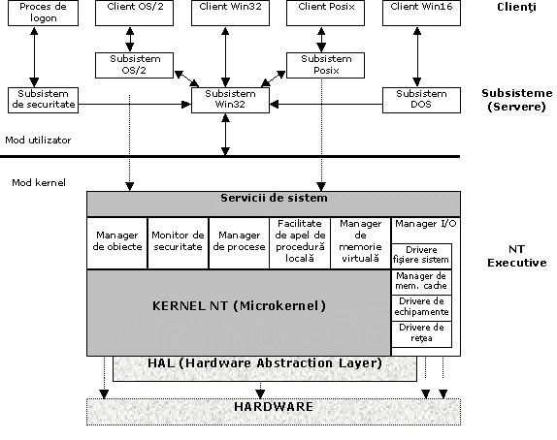
Windows 11 architecture (NT Hybrid Kernel)

Slide 25
Windows Kernel
The kernel is dealing with the whole traffic of messages inside the OS and is running over HAL. The kernel is occupied with interrupts & exceptions handling for the communication between the subsystems and the hardware resources of the OS.
An integral part of the communication management of the subsystems, the kernel is responsible with the constant checking with the security subsystem of the NT executive in order to assure the fact that demand services were authorized accordingly.

Slide 26
Windows Kernel
The kernel is responsible for:
Synchronizing multiple processors when Windows 10/11 is running on a computer with symmetrical multiprocessing (multiprocessor machine);
Handling interrupts and exceptions;
System recovery in case of failure;
Checking security restrictions and/or violations;
Threads programming in the multi-threading environment
Interrupt handling is occupying the most part of the kernel time, an interrupt being generated for each interaction of the NT executive subsystems.
The kernel is running in privileged mode and it cannot expelled from memory.

Slide 27
Windows NT Executive
The NT Executive is made of the kernel plus a variety of subsystems known as system services.
Examples of this kind of services are:
I/O manager;
Local procedure call manager;
Object manager;
Process manager;
Virtual memory manager;
Security monitor.

Slide 28
I/O manager
The main task of it is to manage all the inputs and outputs for the OS.
The I/O manager manages the communications between device drivers, network drivers, cache memory management and file system drivers.
Device drivers are written specially to support certain peripherals like printers, keyboards and mouse.
Due to this standardized medium the device drivers can run on any platform which supporting Windows. These drivers are written in C and can be easily modified.
Among the network drivers we may find: SMB/CIFS, RDP, WinRM server interface. Also, there are included the most common communication protocols like TCP/IP, HTTP/S, TLS, SMB 3.x, WinRM, etc.

Slide 29
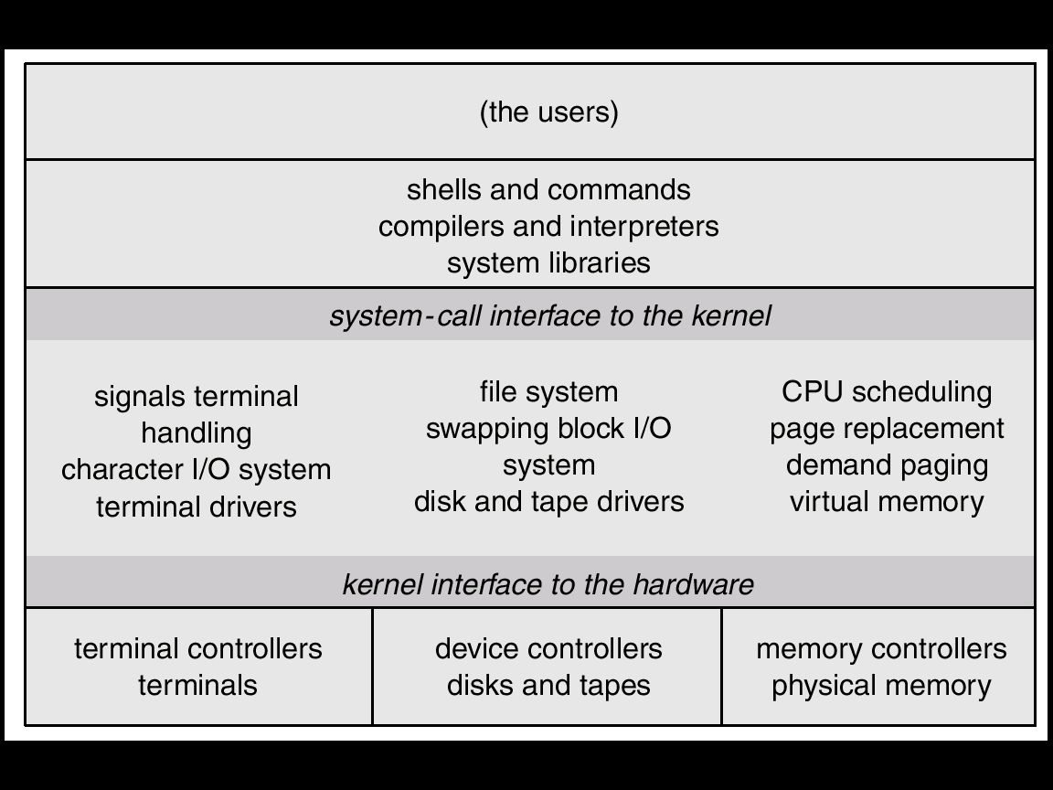
Unix/Linux structure

Slide 30
Virtual machines
Definition from techopedia.com: “A virtual machine (VM) is a software program or operating system that not only exhibits the behavior of a separate computer, but is also capable of performing tasks such as running applications and programs like a separate computer. A virtual machine, usually known as a guest is created within another computing environment referred as a "host“. Multiple virtual machines can exist within a single host at one time.”
Virtual user
User
Virtual machine
“Monitor mode”
Physical machine
Notes:
In a virtual machine each OS seems to execute on its own processor, with its own memory, hardware, etc.

Slide 31
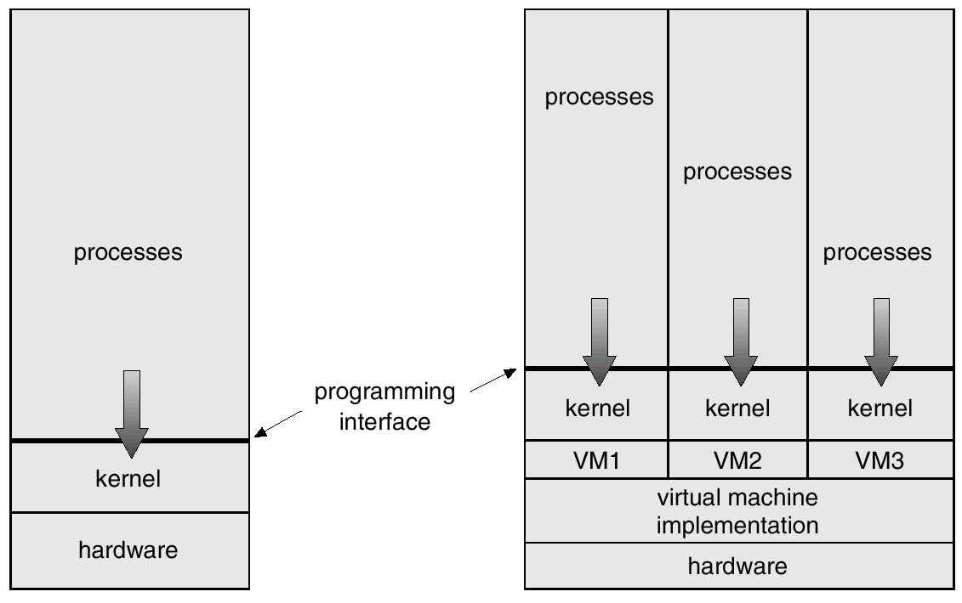
Virtual machines

Slide 32
Virtual machines applications
Examples (free apps): VirtualBox (Win/Mac/Linux), VMware Workstation Pro (Win/Linux) — now free, QEMU+KVM (Linux), Proxmox VE
VirtualBox (Oracle) - https://www.virtualbox.org
VMware Workstation Pro (Broadcom) — FREE since Nov 2024 - https://www.vmware.com/products/workstation-pro.html
QEMU – https://www.qemu.org

