Slide 1
NAT
Network Address Translation
How private networks share a single public IP address
IPv4 Exhaustion
RFC 3022
PAT / NAPT
Home Router
Enterprise Networks

Slide 2
Why NAT? The problem with IPv4
IPv4 has only ~4.3 billion addresses — the Internet ran out in 2011
IPv4 Address Space
IPv4 Address Space
NAT Solution
Total addresses
The Core Idea:
Many private devices share one public IP address. The router keeps a translation table to track which internal device made which request.
4,294,967,296
Devices needing IP
15+ billion
PC-1
Last IPv4 block
192.168.1.10
Feb 2011 (IANA)
R
1 IP
PC-2
Solution
192.168.1.11
NAT + IPv6
Single public IP
Phone
192.168.1.12

Slide 3
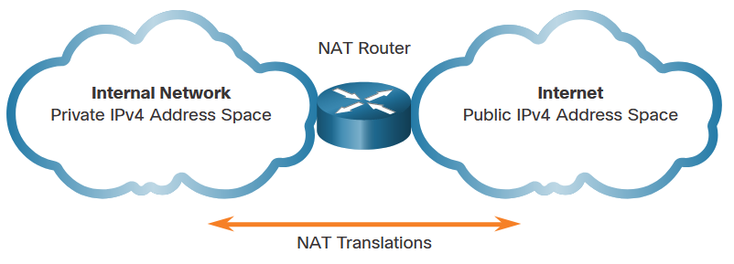
NAT Characteristics IPv4 Address Space
Networks are commonly implemented using private IPv4 addresses, as defined in RFC 1918.
Private IPv4 addresses cannot be routed over the internet and are used within an organization or site to allow devices to communicate locally.
To allow a device with a private IPv4 address to access devices and resources outside of the local network, the private address must first be translated to a public address.
NAT provides the translation of private addresses to public addresses.
Class | Activity Type | Activity Name
A | 10.0.0.0 – 10.255.255.255 | 10.0.0.0/8
B | 172.16.0.0 – 172.31.255.255 | 172.16.0.0/12
C | 192.168.0.0 – 192.168.255.255 | 192.168.0.0/16
Notes:
6.0 – NAT for IPv4
6.1 – NAT Characteristics
6.1.2 – IPv4 Address Space

Slide 4
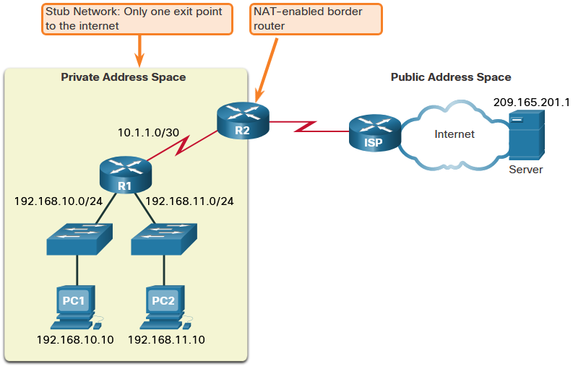
NAT Characteristics What is NAT
The primary use of NAT is to conserve public IPv4 addresses.
NAT allows networks to use private IPv4 addresses internally and translates them to a public address when needed.
A NAT router typically operates at the border of a stub network.
When a device inside the stub network wants to communicate with a device outside of its network, the packet is forwarded to the border router which performs the NAT process, translating the internal private address of the device to a public, outside, routable address.
Notes:
6.0 – NAT for IPv4
6.1 – NAT Characteristics
6.1.2 – What is NAT

Slide 5
Network Setup — The actors in our example
Three private clients, one NAT router, one web server on the Internet
PRIVATE NETWORK
Alice
INTERNET
192.168.1.10
192.168.1.10
Web Server
93.184.216.34
93.184.216.34
R
Bob
Private IP (192.168.x.x) — not routable on Internet
192.168.1.11
NAT Router
192.168.1.11
Public: 203.0.113.5
Private: 192.168.1.1
Public IP (203.0.113.5) — globally routable
Public server IP (93.184.216.34)
Carol
192.168.1.12

Slide 6
Step 1 — Alice sends a request
1
Alice's browser connects to the web server on port 80
PRIVATE
Original packet
INTERNET
Alice
ORIGINAL PACKET
Alice
192.168.1.10
TRANSLATED PACKET
SRC: 192.168.1.10:54321
SRC: 203.0.113.5:10201
DST: 93.184.216.34:80
Web Server
R
DST: 93.184.216.34:80
93.184.216.34
DATA: GET / HTTP/1.1
DATA: GET / HTTP/1.1
Bob
NAT Router
192.168.1.11
Carol
NAT Table entry created: 192.168.1.10:54321 ↔ 203.0.113.5:10201 (→ 93.184.216.34:80)
192.168.1.12

Slide 7
The NAT Translation Table — PAT in Action
Port Address Translation tracks every connection uniquely
After all three clients make requests, the NAT table looks like this:
Private IP:Port
→
Public IP:Port
→
Destination
192.168.1.10:54321
→
203.0.113.5:10201
→
93.184.216.34:80
Alice
192.168.1.10:54322
→
203.0.113.5:10202
→
8.8.8.8:53
Alice
192.168.1.11:61000
→
203.0.113.5:10203
→
93.184.216.34:80
Bob
192.168.1.12:49500
→
203.0.113.5:10204
→
172.217.16.196:443
Carol
192.168.1.11:61001
→
203.0.113.5:10205
→
93.184.216.34:443
Bob
Gray row = expired/closed connection (TCP FIN received) — router removes it after timeout

Slide 8
Step 2 — The server replies back to Alice
2
The router translates the destination back to Alice's private IP
INTERNET
Web Server
93.184.216.34
93.184.216.34
R
TRANSLATED REPLY
SERVER RESPONSE
SRC: 93.184.216.34:80
SRC: 93.184.216.34:80
DST: 192.168.1.10:54321
DST: 203.0.113.5:10201
NAT Router
DATA: HTTP/1.1 200 OK
NAT Lookup
NAT Lookup
DATA: HTTP/1.1 200 OK
DST 203.0.113.5:10201
→ maps to →
192.168.1.10:54321
arrives at router
Alice
192.168.1.10
The server never knew Alice's real IP — it only communicated with the router's public address 203.0.113.5

Slide 9
Complete NAT Flow — All steps at a glance
A single HTTP request from Alice to the web server
1
Alice sends packet
SRC: 192.168.1.10:54321 → DST: 93.184.216.34:80
2
Router rewrites source
SRC becomes: 203.0.113.5:10201
3
Packet traverses Internet
Routed as normal public IP traffic
4
Server replies
DST: 203.0.113.5:10201 (public port)
5
Router looks up table
10201 → maps back to 192.168.1.10:54321
6
Packet delivered to Alice
REQUEST
DST rewritten: 192.168.1.10:54321
RESPONSE
Key insight: NAT is stateful — the router must remember every active connection. If it reboots, all connections drop.

Slide 10
NAT types, benefits & limitations
Not all NAT is equal — understanding the trade-offs
Types of NAT
Benefits
Limitations
Static NAT
✓ Conserves IPv4 addresses
✗ Breaks end-to-end connectivity
One-to-one mapping. One private IP ↔ one public IP. Used for servers.
✓ Hides internal network topology
✗ Problematic for P2P / VoIP
Dynamic NAT
✓ Adds implicit firewall layer
✗ Stateful = single point of failure
Pool of public IPs. Private hosts mapped to available public IPs on demand.
✓ Transparent to end users
✗ Port forwarding required for servers
PAT / NAPT
Many-to-one using ports. Most home routers use this. All clients share one IP.
✓ Widely supported on all devices
✗ IPv6 makes NAT unnecessary
IPv6 Note: With IPv6's 128-bit addresses (340 undecillion), every device gets a globally unique IP — NAT becomes unnecessary. But IPv4 NAT will remain common for decades.

Slide 11
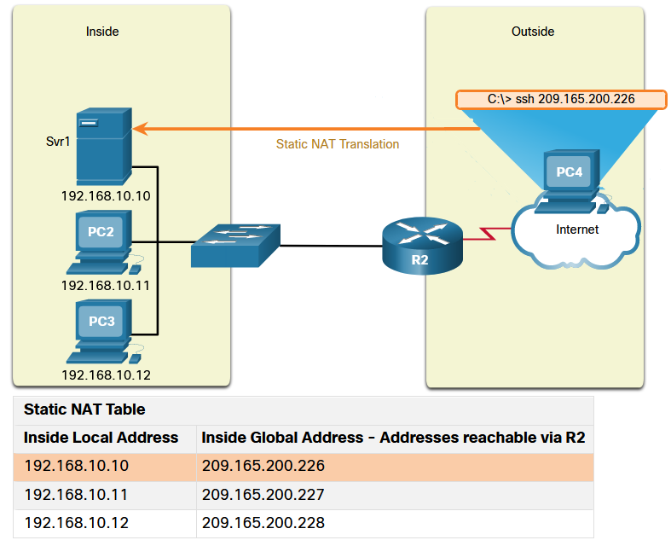
Types of NAT Static NAT
Static NAT uses a one-to-one mapping of local and global addresses configured by the network administrator that remain constant.
Static NAT is useful for web servers or devices that must have a consistent address that is accessible from the internet, such as a company web server.
It is also useful for devices that must be accessible by authorized personnel when offsite, but not by the general public on the internet.
Note: Static NAT requires that enough public addresses are available to satisfy the total number of simultaneous user sessions.
Notes:
6.0 – NAT for IPv4
6.2 – Types of NAT
6.2.1 – Static NAT

Slide 12
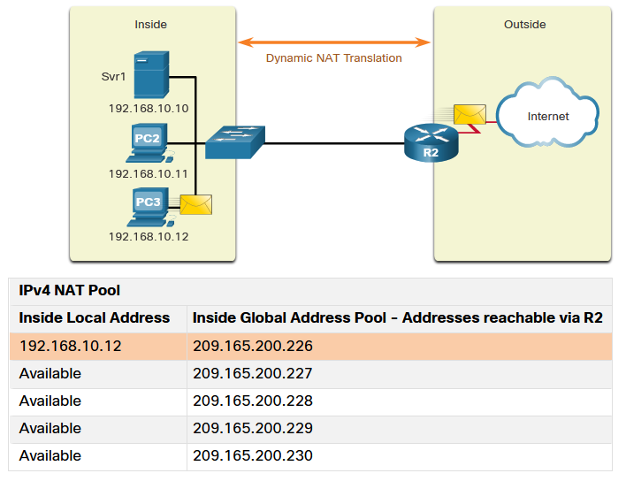
Types of NAT Dynamic NAT
Dynamic NAT uses a pool of public addresses and assigns them on a first-come, first-served basis.
When an inside device requests access to an outside network, dynamic NAT assigns an available public IPv4 address from the pool.
The other addresses in the pool are still available for use.
Note: Dynamic NAT requires that enough public addresses are available to satisfy the total number of simultaneous user sessions.
Notes:
6.0 – NAT for IPv4
6.2 – Types of NAT
6.2.2 – Dynamic NAT

Slide 13
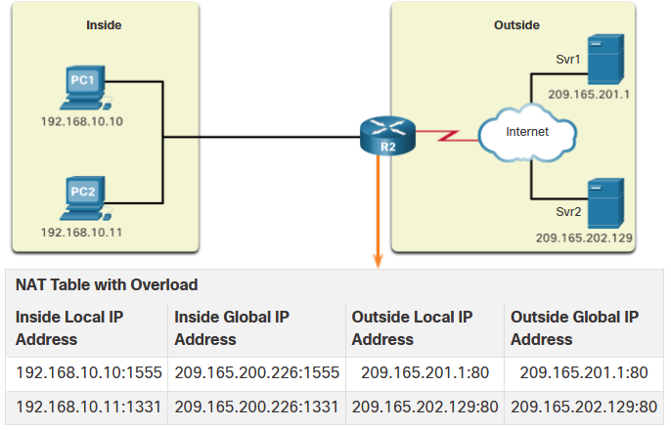
Types of NAT Port Address Translation
Port Address Translation (PAT), also known as NAT overload, maps multiple private IPv4 addresses to a single public IPv4 address or a few addresses.
With PAT, when the NAT router receives a packet from the client, it uses the source port number to uniquely identify the specific NAT translation.
PAT ensures that devices use a different TCP port number for each session with a server on the internet.
Notes:
6.0 – NAT for IPv4
6.2 – Types of NAT
6.2.3 – Port Address Translation

Slide 14
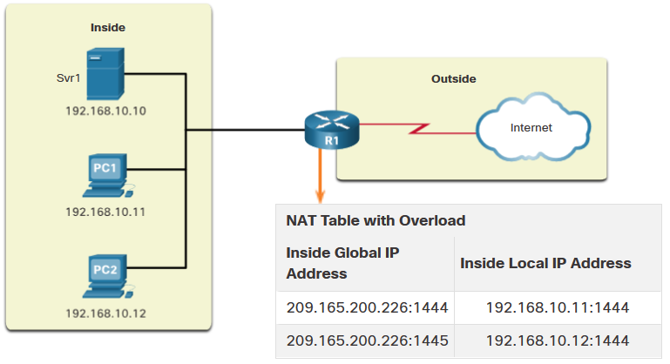
Types of NAT Next Available Port
PAT attempts to preserve the original source port. If the original source port is already used, PAT assigns the first available port number starting from the beginning of the appropriate port group 0-511, 512-1,023, or 1,024-65,535.
When there are no more ports available and there is more than one external address in the address pool, PAT moves to the next address to try to allocate the original source port.
The process continues until there are no more available ports or external IPv4 addresses in the address pool.
Notes:
6.0 – NAT for IPv4
6.2 – Types of NAT
6.2.4 – Next Available Port

Slide 15
Types of NAT NAT and PAT Comparison
Summary of the differences between NAT and PAT.
NAT - Only modifies the IPv4 addresses
PAT - PAT modifies both the IPv4 address and the port number.
NAT | PAT
One-to-one mapping between Inside Local and Inside Global addresses. | One Inside Global address can be mapped to many Inside Local addresses.
Uses only IPv4 addresses in translation process. | Uses IPv4 addresses and TCP or UDP source port numbers in translation process.
A unique Inside Global address is required for each inside host accessing the outside network. | A single unique Inside Global address can be shared by many inside hosts accessing the outside network.
Inside Global Address | Inside Local Address
209.165.200.226 | 192.168.10.10
Inside Global Address | Inside Local Address
209.165.200.226:2031 | 192.168.10.10:2031
Notes:
6.0 – NAT for IPv4
6.2 – Types of NAT
6.2.5 – NAT and PAT Comparison

