Slide 2
Internetul “tuturor lucrurilor”

Slide 3
Ce este IoE ?

Slide 4
Evoluția Internetului

Slide 5
Internetul – “un loc unde mergem”?
http://www.submarinecablemap.com/

Slide 6
Tranziția către IoE

Slide 7
“The circle story”
Într-un timp foarte scurt, Internetul a schimbat modul în care muncim, trăim, ne jucăm și învățăm.
Este vorba despre conectarea lucrurilor ne-conectate încă – în timpul tranziției de la Internet la IoE.
Viziunea Cisco asupra modului în care IoE ne poate afecta viețile:
https://www.youtube.com/watch?v=3D8Fkn5fJg0

Slide 8
IoT will move us forward ☺

Slide 9
Oameni, Procese, Date, Lucruri

Slide 10
Trei mari tipuri de conexiuni

Slide 11
Nevoia de adaptare
Notes:
Doar schimbarea este veşnică.

Slide 12
Nevoia de adaptare
Oamenii, afacerile și guvernele trebuie să se adapteze constant la schimbare.
În 2012 numărul echipamentelor conectate la Internet a depășit numărul oamenilor de pe Terra.
Evoluțiile tehnologice au făcut ca astăzi oamenii să schimbe mai multe informații, idei și opinii față de trecut. Internetul schimbă modul de comunicare, colaborare, învățare.
Oamenii au acum posibilitatea de a reacționa la știrile curente, evenimente, produse, etc. mai mult decât oricând. Abilitatea de a culege informații și/sau de aprocesa informația folosind puterea de procesare este la distanța de un click de mouse sau de o atingere a ecranului.
Notes:
Doar schimbarea este veşnică.

Slide 13
Smart cities - Barcelona
https://www.youtube.com/watch?v=TCbvxb5t5_8

Slide 14
“Hyper-aware”, Predictiv, Agil

Slide 15
Aplicații IoE în producție

Slide 16
Aplicații IoE în domeniul energiei

Slide 17
Aplicații IoE în comerț

Slide 18
Priorități de bază

Slide 19
Maximizarea valorii IoE

Slide 20
“Cei 4 piloni”

Slide 21
Lucrurile
Lucrurile sunt reprezentate de computere și alte echipamente de calcul, laptop-uri, tablete, smartphone-uri, clustere de calculatoare, etc. IoT va include însă toate tipurile de obiecte, chiar și cele care, tradițional, nu sunt conectate. Cisco estimează că la un moment dat, 99% dintre lucruri vor fi conectate.
Aceste obiecte conțin tehnologie ce poate interacționa cu servere interne sau externe; ele pot comunica într-o rețea securizată, fiabilă și disponibilă.
Conceptul IoE este construit în jurul conexiunilor dintre oameni, procese, date și lucruri. Aceștia sunt pilonii de bază ai IoE, dar nu pot fi priviți izolat. Fiecare amplifică capacitățile celorlalți trei. La intersecția celor 4 elemente se află adevărata putere a IoE.

Slide 22
Lucruri încă neconectate la Internet
Currently, the things pillar, highlighted in the figure, is mostly comprised of various types of traditional computers and computing devices, such as desktops, laptops, smartphones, tablets, mainframes, and computer clusters. However, the IoT will include all types of objects, including objects and devices that are not traditionally connected. In fact, Cisco estimates that 99 percent of physical objects will one day be connected.
These objects contain embedded technology to interact with internal servers and the external environment. These objects are network-capable, and can communicate across a secure, reliable and available network platform. However, the IoT refers to a single technology transition; the ability to connect objects that were previously unconnected so those objects can communicate across the network.
The availability of data, when objects can sense and communicate, has the capability of changing how and where decisions are made, who makes the decisions, and the processes that individuals and businesses use to make those decisions. The IoE is built on the connections among people, processes, data, and things. These are the four pillars of the IoE, as shown in the figure. However, the IoE is not about these four dimensions in isolation. Each amplifies the capabilities of the other three. It is in the intersection of all of these elements that the true power of the IoE is realized.

Slide 23
Senzori
Currently, the things pillar, highlighted in the figure, is mostly comprised of various types of traditional computers and computing devices, such as desktops, laptops, smartphones, tablets, mainframes, and computer clusters. However, the IoT will include all types of objects, including objects and devices that are not traditionally connected. In fact, Cisco estimates that 99 percent of physical objects will one day be connected.
These objects contain embedded technology to interact with internal servers and the external environment. These objects are network-capable, and can communicate across a secure, reliable and available network platform. However, the IoT refers to a single technology transition; the ability to connect objects that were previously unconnected so those objects can communicate across the network.
The availability of data, when objects can sense and communicate, has the capability of changing how and where decisions are made, who makes the decisions, and the processes that individuals and businesses use to make those decisions. The IoE is built on the connections among people, processes, data, and things. These are the four pillars of the IoE, as shown in the figure. However, the IoE is not about these four dimensions in isolation. Each amplifies the capabilities of the other three. It is in the intersection of all of these elements that the true power of the IoE is realized.

Slide 24
RFID
Currently, the things pillar, highlighted in the figure, is mostly comprised of various types of traditional computers and computing devices, such as desktops, laptops, smartphones, tablets, mainframes, and computer clusters. However, the IoT will include all types of objects, including objects and devices that are not traditionally connected. In fact, Cisco estimates that 99 percent of physical objects will one day be connected.
These objects contain embedded technology to interact with internal servers and the external environment. These objects are network-capable, and can communicate across a secure, reliable and available network platform. However, the IoT refers to a single technology transition; the ability to connect objects that were previously unconnected so those objects can communicate across the network.
The availability of data, when objects can sense and communicate, has the capability of changing how and where decisions are made, who makes the decisions, and the processes that individuals and businesses use to make those decisions. The IoE is built on the connections among people, processes, data, and things. These are the four pillars of the IoE, as shown in the figure. However, the IoE is not about these four dimensions in isolation. Each amplifies the capabilities of the other three. It is in the intersection of all of these elements that the true power of the IoE is realized.

Slide 25
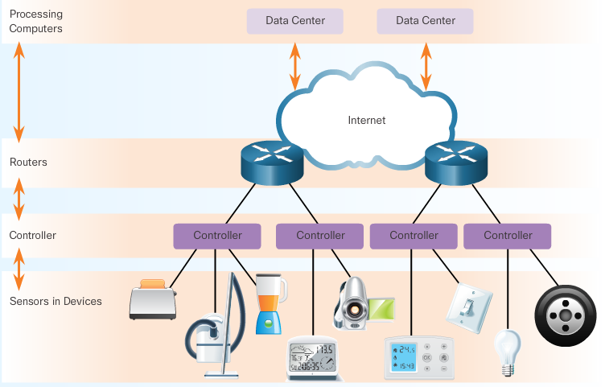
Controlere
Currently, the things pillar, highlighted in the figure, is mostly comprised of various types of traditional computers and computing devices, such as desktops, laptops, smartphones, tablets, mainframes, and computer clusters. However, the IoT will include all types of objects, including objects and devices that are not traditionally connected. In fact, Cisco estimates that 99 percent of physical objects will one day be connected.
These objects contain embedded technology to interact with internal servers and the external environment. These objects are network-capable, and can communicate across a secure, reliable and available network platform. However, the IoT refers to a single technology transition; the ability to connect objects that were previously unconnected so those objects can communicate across the network.
The availability of data, when objects can sense and communicate, has the capability of changing how and where decisions are made, who makes the decisions, and the processes that individuals and businesses use to make those decisions. The IoE is built on the connections among people, processes, data, and things. These are the four pillars of the IoE, as shown in the figure. However, the IoE is not about these four dimensions in isolation. Each amplifies the capabilities of the other three. It is in the intersection of all of these elements that the true power of the IoE is realized.

Slide 26
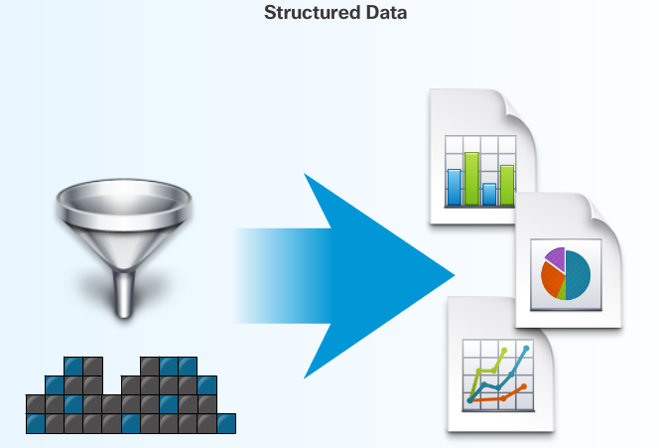
Date – managementul datelor

Slide 27
Date – managementul datelor
Currently, the things pillar, highlighted in the figure, is mostly comprised of various types of traditional computers and computing devices, such as desktops, laptops, smartphones, tablets, mainframes, and computer clusters. However, the IoT will include all types of objects, including objects and devices that are not traditionally connected. In fact, Cisco estimates that 99 percent of physical objects will one day be connected.
These objects contain embedded technology to interact with internal servers and the external environment. These objects are network-capable, and can communicate across a secure, reliable and available network platform. However, the IoT refers to a single technology transition; the ability to connect objects that were previously unconnected so those objects can communicate across the network.
The availability of data, when objects can sense and communicate, has the capability of changing how and where decisions are made, who makes the decisions, and the processes that individuals and businesses use to make those decisions. The IoE is built on the connections among people, processes, data, and things. These are the four pillars of the IoE, as shown in the figure. However, the IoE is not about these four dimensions in isolation. Each amplifies the capabilities of the other three. It is in the intersection of all of these elements that the true power of the IoE is realized.

Slide 28
Date locale
Currently, the things pillar, highlighted in the figure, is mostly comprised of various types of traditional computers and computing devices, such as desktops, laptops, smartphones, tablets, mainframes, and computer clusters. However, the IoT will include all types of objects, including objects and devices that are not traditionally connected. In fact, Cisco estimates that 99 percent of physical objects will one day be connected.
These objects contain embedded technology to interact with internal servers and the external environment. These objects are network-capable, and can communicate across a secure, reliable and available network platform. However, the IoT refers to a single technology transition; the ability to connect objects that were previously unconnected so those objects can communicate across the network.
The availability of data, when objects can sense and communicate, has the capability of changing how and where decisions are made, who makes the decisions, and the processes that individuals and businesses use to make those decisions. The IoE is built on the connections among people, processes, data, and things. These are the four pillars of the IoE, as shown in the figure. However, the IoE is not about these four dimensions in isolation. Each amplifies the capabilities of the other three. It is in the intersection of all of these elements that the true power of the IoE is realized.

Slide 29
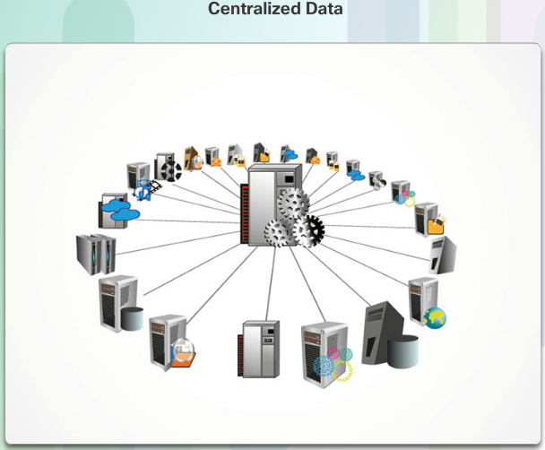
Date centralizate
Currently, the things pillar, highlighted in the figure, is mostly comprised of various types of traditional computers and computing devices, such as desktops, laptops, smartphones, tablets, mainframes, and computer clusters. However, the IoT will include all types of objects, including objects and devices that are not traditionally connected. In fact, Cisco estimates that 99 percent of physical objects will one day be connected.
These objects contain embedded technology to interact with internal servers and the external environment. These objects are network-capable, and can communicate across a secure, reliable and available network platform. However, the IoT refers to a single technology transition; the ability to connect objects that were previously unconnected so those objects can communicate across the network.
The availability of data, when objects can sense and communicate, has the capability of changing how and where decisions are made, who makes the decisions, and the processes that individuals and businesses use to make those decisions. The IoE is built on the connections among people, processes, data, and things. These are the four pillars of the IoE, as shown in the figure. However, the IoE is not about these four dimensions in isolation. Each amplifies the capabilities of the other three. It is in the intersection of all of these elements that the true power of the IoE is realized.

Slide 30
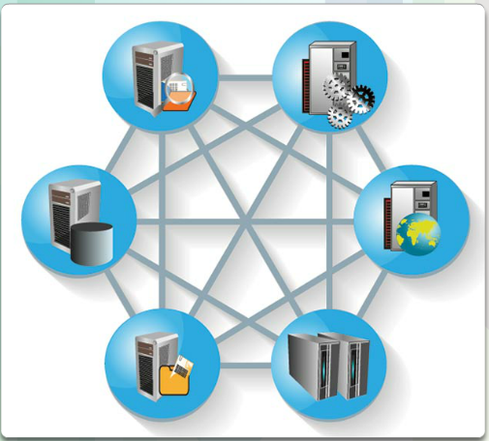
Date distribuite
Currently, the things pillar, highlighted in the figure, is mostly comprised of various types of traditional computers and computing devices, such as desktops, laptops, smartphones, tablets, mainframes, and computer clusters. However, the IoT will include all types of objects, including objects and devices that are not traditionally connected. In fact, Cisco estimates that 99 percent of physical objects will one day be connected.
These objects contain embedded technology to interact with internal servers and the external environment. These objects are network-capable, and can communicate across a secure, reliable and available network platform. However, the IoT refers to a single technology transition; the ability to connect objects that were previously unconnected so those objects can communicate across the network.
The availability of data, when objects can sense and communicate, has the capability of changing how and where decisions are made, who makes the decisions, and the processes that individuals and businesses use to make those decisions. The IoE is built on the connections among people, processes, data, and things. These are the four pillars of the IoE, as shown in the figure. However, the IoE is not about these four dimensions in isolation. Each amplifies the capabilities of the other three. It is in the intersection of all of these elements that the true power of the IoE is realized.

Slide 31
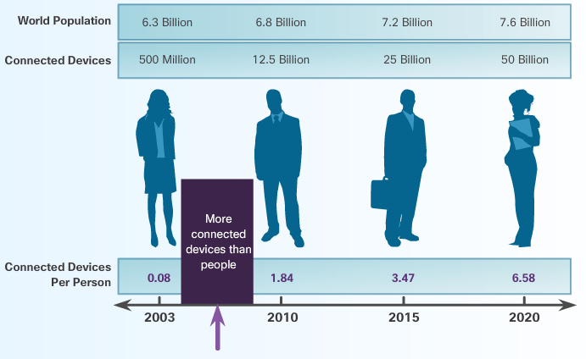
Mai multe conexiuni în rețea – mai multe date
Currently, the things pillar, highlighted in the figure, is mostly comprised of various types of traditional computers and computing devices, such as desktops, laptops, smartphones, tablets, mainframes, and computer clusters. However, the IoT will include all types of objects, including objects and devices that are not traditionally connected. In fact, Cisco estimates that 99 percent of physical objects will one day be connected.
These objects contain embedded technology to interact with internal servers and the external environment. These objects are network-capable, and can communicate across a secure, reliable and available network platform. However, the IoT refers to a single technology transition; the ability to connect objects that were previously unconnected so those objects can communicate across the network.
The availability of data, when objects can sense and communicate, has the capability of changing how and where decisions are made, who makes the decisions, and the processes that individuals and businesses use to make those decisions. The IoE is built on the connections among people, processes, data, and things. These are the four pillars of the IoE, as shown in the figure. However, the IoE is not about these four dimensions in isolation. Each amplifies the capabilities of the other three. It is in the intersection of all of these elements that the true power of the IoE is realized.

Slide 32
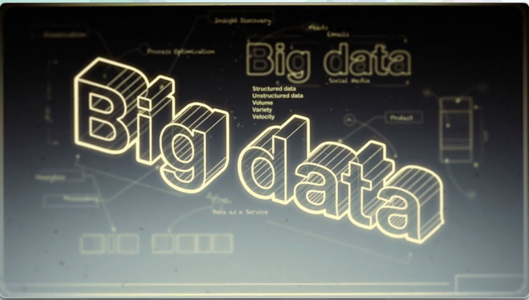
Administrarea “Big data”
Currently, the things pillar, highlighted in the figure, is mostly comprised of various types of traditional computers and computing devices, such as desktops, laptops, smartphones, tablets, mainframes, and computer clusters. However, the IoT will include all types of objects, including objects and devices that are not traditionally connected. In fact, Cisco estimates that 99 percent of physical objects will one day be connected.
These objects contain embedded technology to interact with internal servers and the external environment. These objects are network-capable, and can communicate across a secure, reliable and available network platform. However, the IoT refers to a single technology transition; the ability to connect objects that were previously unconnected so those objects can communicate across the network.
The availability of data, when objects can sense and communicate, has the capability of changing how and where decisions are made, who makes the decisions, and the processes that individuals and businesses use to make those decisions. The IoE is built on the connections among people, processes, data, and things. These are the four pillars of the IoE, as shown in the figure. However, the IoE is not about these four dimensions in isolation. Each amplifies the capabilities of the other three. It is in the intersection of all of these elements that the true power of the IoE is realized.
Există 3 dimensiuni de bază pentru Big Data: volumul, varietatea și viteza.
- Volumul descrie cantitatea de date ce este transportată și stocată.
- Varietatea descrie tipul de date.
- Viteza descrie rata de transfer a datelor.
Datele nu se pot mișca fără o infrastructură. Caracteristicile acesteia (input/output, lățime de bandă și latență), precum și abilitatea de a oferi resurse optime (rețea, procesor, memorie și capacitate de stocare) afectează în mod direct viteza de transport a datelor.

Slide 33
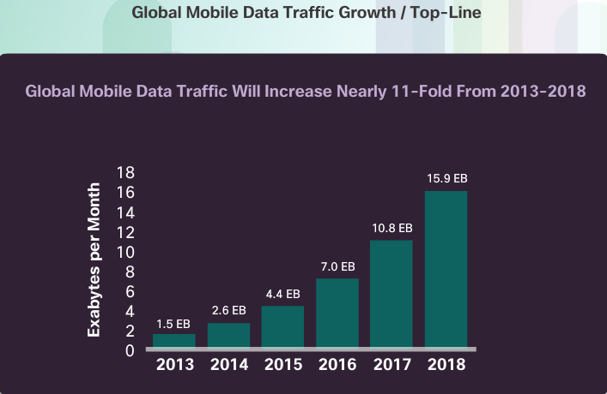
Big data analytics
Currently, the things pillar, highlighted in the figure, is mostly comprised of various types of traditional computers and computing devices, such as desktops, laptops, smartphones, tablets, mainframes, and computer clusters. However, the IoT will include all types of objects, including objects and devices that are not traditionally connected. In fact, Cisco estimates that 99 percent of physical objects will one day be connected.
These objects contain embedded technology to interact with internal servers and the external environment. These objects are network-capable, and can communicate across a secure, reliable and available network platform. However, the IoT refers to a single technology transition; the ability to connect objects that were previously unconnected so those objects can communicate across the network.
The availability of data, when objects can sense and communicate, has the capability of changing how and where decisions are made, who makes the decisions, and the processes that individuals and businesses use to make those decisions. The IoE is built on the connections among people, processes, data, and things. These are the four pillars of the IoE, as shown in the figure. However, the IoE is not about these four dimensions in isolation. Each amplifies the capabilities of the other three. It is in the intersection of all of these elements that the true power of the IoE is realized.

Slide 34
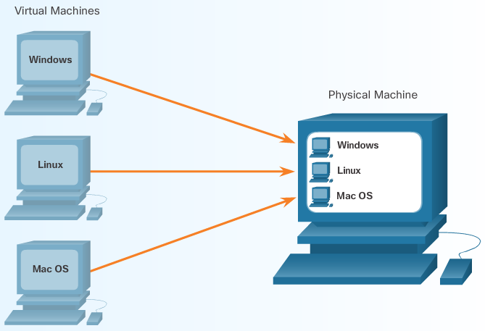
Virtualizare
Currently, the things pillar, highlighted in the figure, is mostly comprised of various types of traditional computers and computing devices, such as desktops, laptops, smartphones, tablets, mainframes, and computer clusters. However, the IoT will include all types of objects, including objects and devices that are not traditionally connected. In fact, Cisco estimates that 99 percent of physical objects will one day be connected.
These objects contain embedded technology to interact with internal servers and the external environment. These objects are network-capable, and can communicate across a secure, reliable and available network platform. However, the IoT refers to a single technology transition; the ability to connect objects that were previously unconnected so those objects can communicate across the network.
The availability of data, when objects can sense and communicate, has the capability of changing how and where decisions are made, who makes the decisions, and the processes that individuals and businesses use to make those decisions. The IoE is built on the connections among people, processes, data, and things. These are the four pillars of the IoE, as shown in the figure. However, the IoE is not about these four dimensions in isolation. Each amplifies the capabilities of the other three. It is in the intersection of all of these elements that the true power of the IoE is realized.

Slide 35
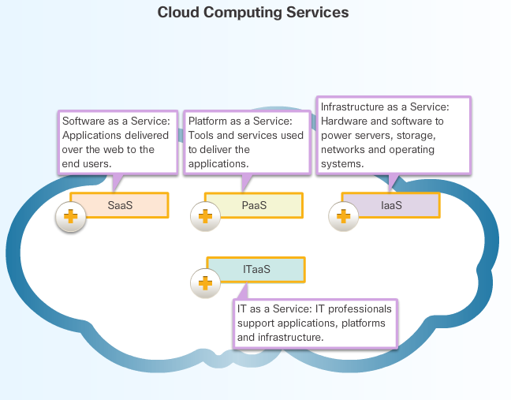
Cloud computing
Currently, the things pillar, highlighted in the figure, is mostly comprised of various types of traditional computers and computing devices, such as desktops, laptops, smartphones, tablets, mainframes, and computer clusters. However, the IoT will include all types of objects, including objects and devices that are not traditionally connected. In fact, Cisco estimates that 99 percent of physical objects will one day be connected.
These objects contain embedded technology to interact with internal servers and the external environment. These objects are network-capable, and can communicate across a secure, reliable and available network platform. However, the IoT refers to a single technology transition; the ability to connect objects that were previously unconnected so those objects can communicate across the network.
The availability of data, when objects can sense and communicate, has the capability of changing how and where decisions are made, who makes the decisions, and the processes that individuals and businesses use to make those decisions. The IoE is built on the connections among people, processes, data, and things. These are the four pillars of the IoE, as shown in the figure. However, the IoE is not about these four dimensions in isolation. Each amplifies the capabilities of the other three. It is in the intersection of all of these elements that the true power of the IoE is realized.

Slide 36
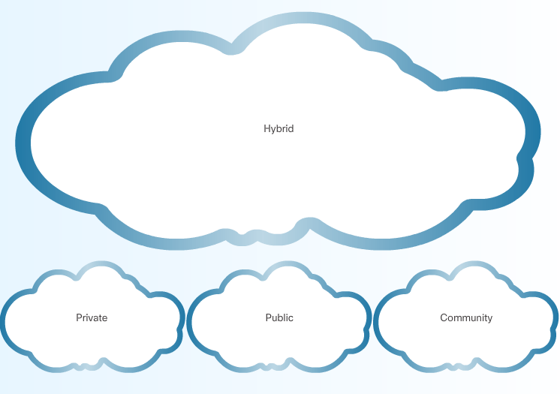
Clouds
Currently, the things pillar, highlighted in the figure, is mostly comprised of various types of traditional computers and computing devices, such as desktops, laptops, smartphones, tablets, mainframes, and computer clusters. However, the IoT will include all types of objects, including objects and devices that are not traditionally connected. In fact, Cisco estimates that 99 percent of physical objects will one day be connected.
These objects contain embedded technology to interact with internal servers and the external environment. These objects are network-capable, and can communicate across a secure, reliable and available network platform. However, the IoT refers to a single technology transition; the ability to connect objects that were previously unconnected so those objects can communicate across the network.
The availability of data, when objects can sense and communicate, has the capability of changing how and where decisions are made, who makes the decisions, and the processes that individuals and businesses use to make those decisions. The IoE is built on the connections among people, processes, data, and things. These are the four pillars of the IoE, as shown in the figure. However, the IoE is not about these four dimensions in isolation. Each amplifies the capabilities of the other three. It is in the intersection of all of these elements that the true power of the IoE is realized.

Slide 37
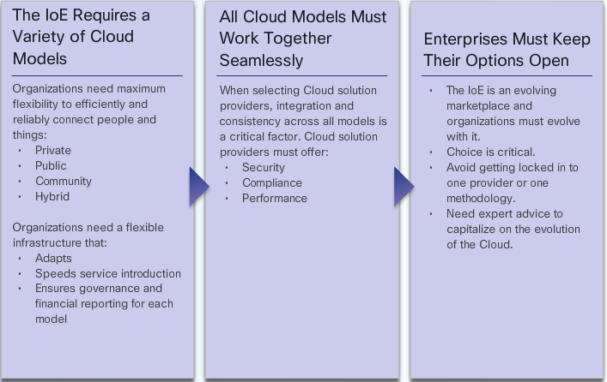
3 conversații tipice de cloud
Currently, the things pillar, highlighted in the figure, is mostly comprised of various types of traditional computers and computing devices, such as desktops, laptops, smartphones, tablets, mainframes, and computer clusters. However, the IoT will include all types of objects, including objects and devices that are not traditionally connected. In fact, Cisco estimates that 99 percent of physical objects will one day be connected.
These objects contain embedded technology to interact with internal servers and the external environment. These objects are network-capable, and can communicate across a secure, reliable and available network platform. However, the IoT refers to a single technology transition; the ability to connect objects that were previously unconnected so those objects can communicate across the network.
The availability of data, when objects can sense and communicate, has the capability of changing how and where decisions are made, who makes the decisions, and the processes that individuals and businesses use to make those decisions. The IoE is built on the connections among people, processes, data, and things. These are the four pillars of the IoE, as shown in the figure. However, the IoE is not about these four dimensions in isolation. Each amplifies the capabilities of the other three. It is in the intersection of all of these elements that the true power of the IoE is realized.

