Slide 1
IT Basics 4
Faculty of Cybernetics, Statistics and Economic Informatics –
BUES
Prof. Răzvan ZOTA, Ph.D.
zota@ase.ro
https://zota.ase.ro/itb

Slide 2
Alphanumeric codes
Examples:
EBCDIC (Extended Binary Coded Decimal Information Interchange)
ASCII (American Standard Code for Information Interchange)
Unicode – supports electronic data exchanges, text processing and displaying in several international languages. It has been adopted by great international companies, like: Apple, HP, IBM, Microsoft, Oracle, Sun, Unisys, etc.
Latest versions – Sept 2022 and 2023 – v15.0 and v15.1 (support for 149.813 characters with 20 new emojis and 4,193 CJK (Chinese, Japanese, and Korean) ideographs)
For more info see: www.unicode.org

Slide 3
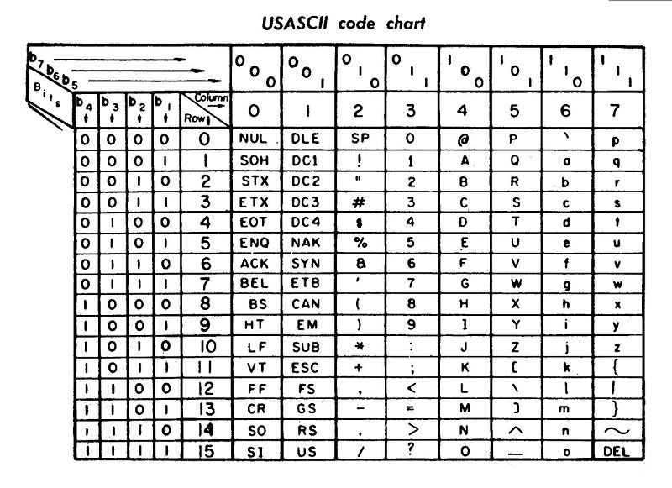

Slide 4
Alphanumeric codes (cont.)
http://www.jimprice.com/jim-asc.shtml
http://tronweb.super-nova.co.jp/characcodehist.html

Slide 5
Alphanumeric codes (cont.)

Slide 6
Numeric codes
Weighted
Non-weighted
Weighted codes (z_{i} are the binary digits from 0 to 9) have the following characteristic: for each code digit it is associated a weight and the value of the decimal number is computed by multiplying the code digit with the (associated) weight and summing the values:

Slide 7
Weighted codes
Decimal digit | 8421 code | 2421 code | 8421 code | Code 50 43210
0 | 0000 | 0000 | 0000 | 01 00001
1 | 0001 | 0001 | 0111 | 01 00010
2 | 0010 | 0010 | 0110 | 01 00100
3 | 0011 | 0011 | 0101 | 01 01000
4 | 0100 | 0100 | 0100 | 01 10000
5 | 0101 | 1011 | 1011 | 10 00001
6 | 0110 | 1100 | 1010 | 10 00010
7 | 0111 | 1101 | 1001 | 10 00100
8 | 1000 | 1110 | 1000 | 10 01000
9 | 1001 | 1111 | 1111 | 10 10000

Slide 8
Weighted codes (cont.)
Decimal digit | 4221 code | 5421 code | 7421 code | Code 6421
0 | 0000 | 0000 | 0000 | 0000
1 | 0001 | 0001 | 0001 | 0011
2 | 0010 | 0010 | 0010 | 0010
3 | 0011 | 0011 | 0011 | 0101
4 | 0110 | 0100 | 0100 | 0100
5 | 1001 | 1000 | 0101 | 0111
6 | 1100 | 1001 | 0110 | 1000
7 | 1101 | 1010 | 0111 | 1011
8 | 1110 | 1011 | 1001 | 1010
9 | 1111 | 1100 | 1010 | 1101

Slide 9
Weighted codes (cont.)
8421 code ⬄ Binary-decimal natural code, with weights powers of 2
2421 code (Aiken) – self-complementary code
8421 code – the last two weights are negative, self-complementary code
(50 43210) code – sequences of 7 binary symbols divided into two groups

Slide 10
Non-weighted codes
Decimal digit | Exces 3 code | Gray code | 2 of 5 (74 210)
0 | 0011 | 0000 | 11 000
1 | 0100 | 0001 | 00 011
2 | 0101 | 0011 | 00 101
3 | 0110 | 0010 | 00 110
4 | 0111 | 0110 | 01 001
5 | 1000 | 0111 | 01 010
6 | 1001 | 0101 | 01 100
7 | 1010 | 0100 | 10 001
8 | 1011 | 1100 | 10 010
9 | 1100 | 1101 | 10 100

Slide 11
Non-weighted codes
Excess 3 code – self-complementary
Gray code – two consecutive code sequences differ by a single bit position
2 of 5 code – pseudo-weighted code; the code sequences for decimal digits 1÷9 have associated the weights 74210 except digit 0. Only 2 from the 5 binary digits are significant (have the value of 1).
Notes:
Gray code:
a₈a₄a₂a₁
g₈g₄g₂g₁
g₈₌a₈
₆₌₀₁₁₀
0101

Slide 12
Barcodes – an example
Barcode 2 of 5– two lines are wide and three are narrow.
The print rate between wide line/narrow line is 2:1 or 3:1.
The spaces do not contain information; for ITF code (Interleaved Two of Five) the information density is bigger because the spaces are containing information also

Slide 13
Barcodes - example

Slide 14
Barcodes - example
Example: number 10 representation with 2 of 5 barcode
START
1
0
STOP

Slide 15
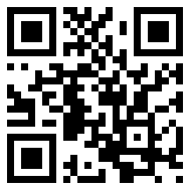
QR (Quick Response) code
Represents a matrix (bi-dimensional) barcode
Example:

